Slide 1
College Technical Math 1
Unit 9 Problems

Slide 2
Unit 9
17.1: Lines and Angles
17.2: Polygons
17.3: Circles and Radians
17.4: Volume and Surface Area

Slide 3
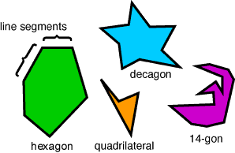
Polygons
A polygon is a simple closed figure that consists of line segments. Each segment is called a side of the polygon.

Slide 4
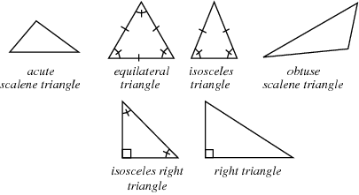
Triangles
Polygons that consist of three(3) sides.

Slide 5
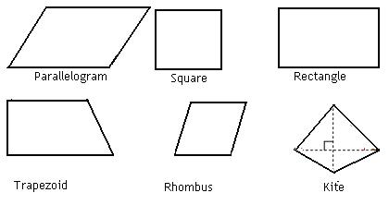
Quadrilaterals
Polygons that consist of four(4) sides.

Slide 6
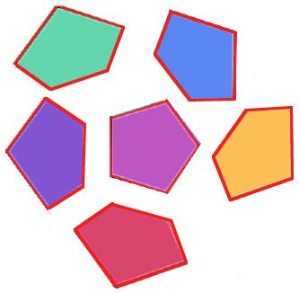
Pentagons
Polygons that consist of five(5) sides.

Slide 7
Hexagons
Polygons that consist of six(6) sides.

Slide 8
Heptagons
Polygons that consist of seven(7) sides.

Slide 9
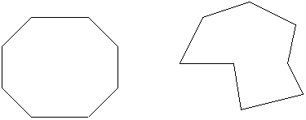
Octagons
Polygons that consist of eight(8) sides.

Slide 10
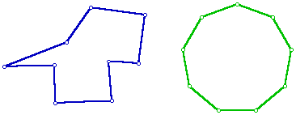
Nonagons
Polygons that consist of nine(9) sides.

Slide 11
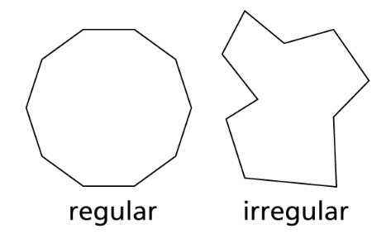
Decagons
Polygons that consist of ten(10) sides.

Slide 12
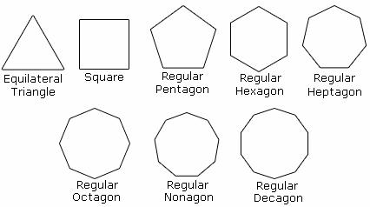
Regular Polygons
Polygons in which all of the sides are equal.

Slide 13
Perimeter
The perimeter of a polygon is a calculation of the distance around the polygon.
Perimeter = sum of the lengths of the sides
[ Units = in., ft, yd, cm, m, ... ]
Formulas for the perimeter of a triangle or quadrilateral are on your formula sheet.

Slide 14
Area
The area of a polygon is a calculation of the amount of surface of a plane figure.
[ Units = in², ft², yd², cm², m², ... ]
Formulas for the area of a triangle or quadrilateral are on your formula sheet. (Note Heron’s formula)

Slide 15
Rectangle
Perimeter:
L
$$P=2L+2W$$
W
W
$$P=2(4 in)+2(2 in)$$
= 2 in.
$$P= 8 in + 4 in$$
L
= 4 in.
$P= 12 in$

Slide 16
Rectangle
Area:
L
$$A=L W$$
W
W
$A=(4 in)(2 in)$
= 2 in.
$$A= 8 in2$$
L
= 4 in.

Slide 17
Square
Perimeter:
s
$$P=4s$$
s
s
$$P=4 (3 cm)$$
$$P=12 cm$$
s
= 3 cm

Slide 18
Square
Area:
s
$$A=s2$$
s
s
$$A=\left(3 cm\right)2$$
$$A=9 cm2$$
s
= 3 cm

Slide 19
Parallelogram
Perimeter:
b
$$P=2b+2s$$
s
s
$$P=2\left(6 ft\right)+2(5 ft)$$
= 5 ft
$$P= 12 ft + 10 ft$$
b
= 6 ft
$$P= 22 ft$$

Slide 20
Parallelogram
Area:
b
$$A=bh$$
s
h
= 4 ft
s
$$A=\left(6 ft\right)(4 ft)$$
$$A= 24 ft2$$
b
= 6 ft

Slide 21
Rhombus
Perimeter:
s
$$P=4s$$
s
s
$$P=4\left(5 m\right)$$
= 5 m
$$P= 20 m$$
s
= 5 m

Slide 22
Rhombus
Area:
b
$$A=bh$$
b
= 8 cm
h
b
$$A=\left(10 cm\right)(8 cm)$$
$$A= 80 cm2$$
b
= 10 cm

Slide 23
Trapeziod
Perimeter:
$$P=b1+b2+a+c$$
b₁
= 10 in
$$P=10 in+16 in+$$
$9 in+12 in$
= 9 in
= 12 in
a
c
s
$$P=45 in$$
b₂
= 16 in

Slide 24
Trapeziod
Area:
$$A=\frac{1}{2}h(b1+b2)$$
b₁
= 10 in
a
h
c
$$A=\frac{1}{2}(8 in)(10 in+16 in)$$
= 8 in
s
$$A= 104 in2$$
b₂
= 16 in

Slide 25
Triangle
Perimeter:
$$P=a+b+c$$
$$P=3 cm+4 cm+5 cm$$
= 3 cm
c
= 4 cm
a
$$P= 12 cm$$
b
= 5 cm

Slide 26
Triangle
Area:
$$A=\frac{1}{2}bh$$
c
$$A=\frac{1}{2}(5 cm)(2.4 cm)$$
a
h
= 2.4 cm
$$A= 6 cm2$$
b
= 5 cm

Slide 27
Triangle
Area: Heron’s Formula
What if you don’t know the height? (But you do know all three sides)
$$s=\frac{1}{2} (a+b+c)$$
$$s=\frac{1}{2}(3 +5 +4)$$
= 3 cm
c
= 4 cm
a
?
$$s=6$$
$$A=\sqrt{s(s−a)(s−b)(s−c)}$$
b
= 5 cm
$$A=\sqrt{6(6−3)(6−5)(6−4)}$$
$A=6 cm2$

Slide 28
Composite Figures
2 cm
Area:
$$A=L W$$
$$A=A1+A2$$
$$A=\left(3 cm\right)\left(2 cm\right)+(2 cm)(6 cm)$$
A₂
6 cm
3 cm
$$A= 6 cm2+12 cm2$$
2 cm
A₁
$$A= 18 cm2$$
5 cm

